Slide 1

Cloud Computing and Microservices Seminar
Author: TungBV
Editor: VinhNB, NamNH67

Slide 2
Contents
Introduction to Cloud Computing
Pros and Cons of Cloud Computing
Why Cloud?
Microservices Architecture
Common Patterns in Microservices Architecture
Best practices and implementations
Summary

Slide 3
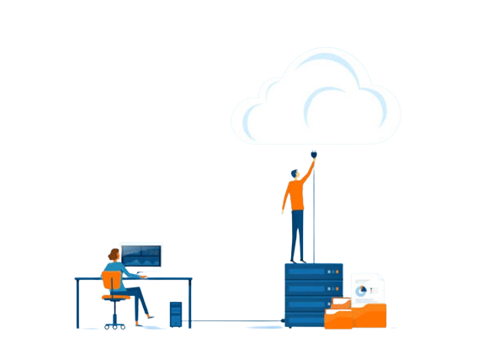

Introduction to Cloud Computing
Cloud computing is the on-demand availability of computer system resources, especially data storage and computing power, without direct active management by the user.
Everything as a service (IaaS, PaaS, SaaS)

Slide 4
Characteristics of Cloud Computing
On-Demand Self-Service: Users can provision resources and services as needed, without requiring human interaction with service providers.
Broad Network Access: Services are accessible over the internet via standard protocols and devices.
Resource Pooling: Computing resources are pooled together to serve multiple users, allowing for efficient utilization and scalability.
Rapid Elasticity: Resources can be scaled up or down quickly to meet changing demands.
Measured Service: Cloud service usage is measured, monitored, and billed based on actual consumption.

Slide 5
Characteristics of Cloud Computing
Multi-tenancy: multiple tenants (users or organizations) can use a single set of shared resources.
Virtualization: abstract underlying hardware resources and present them as logical resources to users.
Resilient computing: fault tolerance, high availability and reliability.
Flexible pricing models: users can choose the option that best suits their needs: pay-per-use, subscription-based, and spot pricing – Public Cloud only
Security: protect users’ data and ensure the privacy of sensitive information.

Slide 6
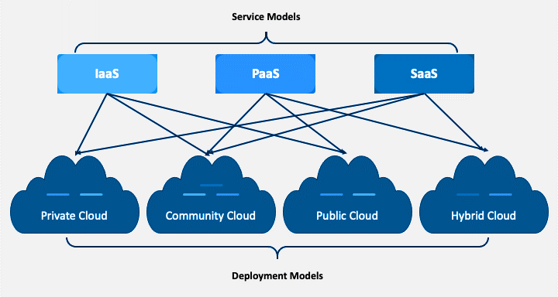
Cloud Deployment Models

Slide 7
Advantages of Cloud Computing
Cost Savings Efficiency: Pay for what you use, with no upfront infrastructure costs.
Scalability: Easily scale resources up or down based on demand.
Flexibility: Access resources and applications from anywhere with an internet connection.
Reliability: Cloud providers typically offer high uptime and data redundancy.
Collaboration: Enable seamless collaboration and data sharing among teams.
Security: Cloud providers invest heavily in security measures, offering stronger security than many on-premise setup.
Up-to-date: Cloud services are regularly updated with latest features and patches

Slide 8
Disadvantages of Cloud Computing
Limited control and flexibility
Security and privacy: Code Spaces case study
Downtime: Network latancy.
Vendor lock-in
Cost concerns

Slide 9
Why Cloud Computing?
So many benefits when migrating to Cloud
Cloud Eco-system
The future of computing is Cloud Computing

Slide 10
Software Architecture
Software architecture is the set of structures needed to reason about a software system and the discipline of creating such structures and systems. Each structure comprises software elements, relations among them, and properties of both elements and relations.
N-Layers
Client – Server
SOA
…

Slide 11
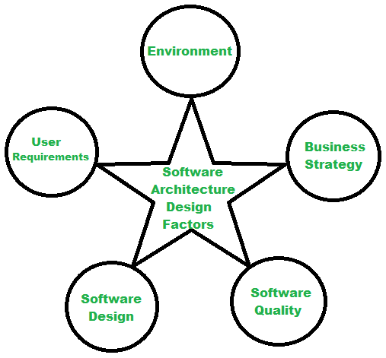
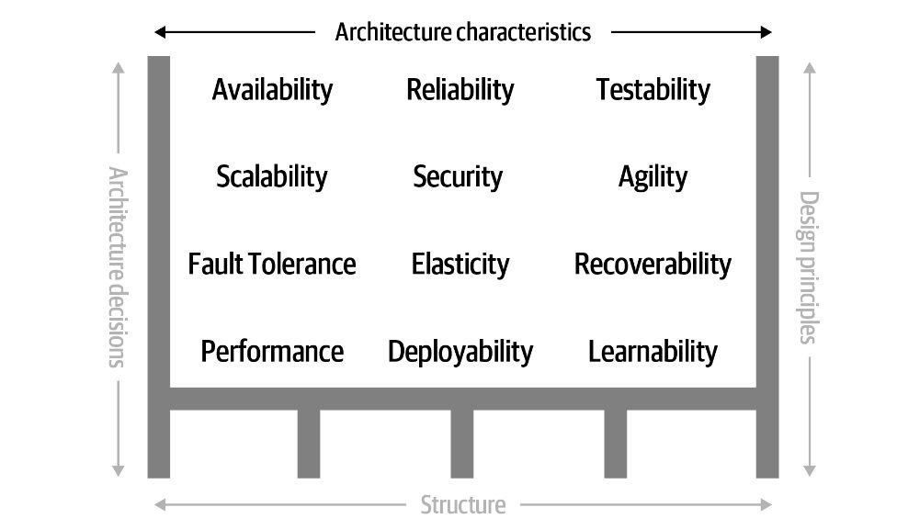
Software Architecture

Slide 12
Service-oriented Architecture
Organize a giant system as a collection of loosely coupled services
Services are coarser-grained and can encompass a boarder set of functionalities
Rely on ESB and use some heavy protocols like SOAP or WS
ECMBPM is a SOA-like system

Slide 13
Microservices Architecture
Break down a software system into smaller, independent services
Each service handles a single function or business capability → Single Responsibility
Each service has its own data storage
Inter-communication protocol is lightweight: REST, gRPC,…
Allow using different technologies, languages,…→ It depends on how well it suited

Slide 14
Advantages of Microservices
Scalability: each service can be scaled independently → More efficient resource (SDD)
Development Speed and Agility: Smaller, each service has a team → focused on business functions only → faster to market
Faults Isolation/Tolerance
Security
…

Slide 15
Disadvantages of Microservices
Increase overall complexity
Require automated deployments
Network latency
Integration/UAT/Performance test
Cost

Slide 16
Why Microservices
Cloud and its benefits are biggest motivation of Microservices
Divide to conquer
Limitless scalability
Trend

Slide 17
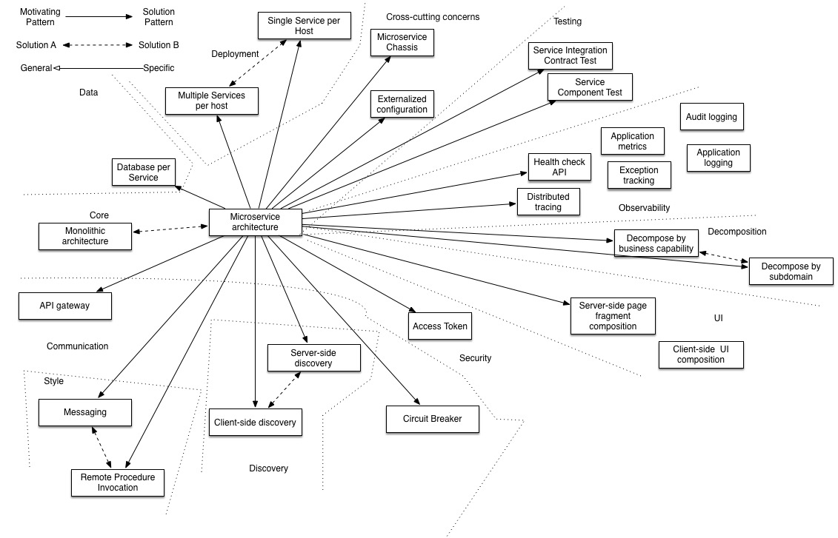
Patterns in Microservices

Slide 18
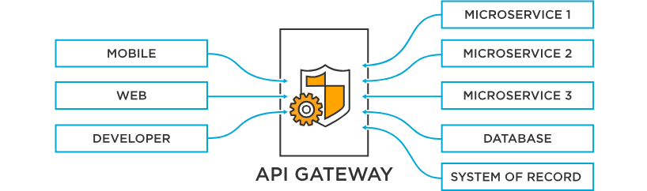
API Gateway

Slide 19
Why API Gateway?
Centralized Entry Point
Request Routing
Load Balancing
Security
Rate Limit and Throttling
Analytics and Monitoring
API Versioning
Transformation and Aggregation

Slide 20
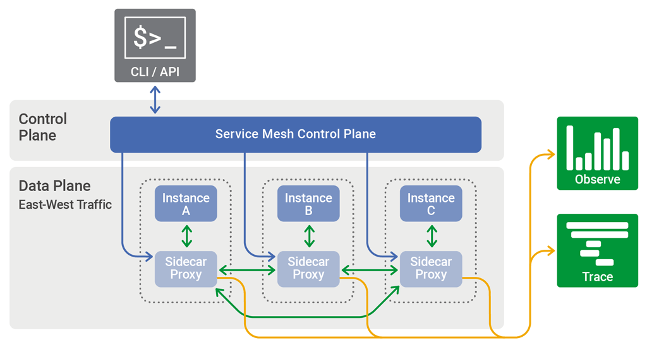
Service Mesh

Slide 21
Why Service Mesh?
Centralized Traffic Management
Resilience and Fault Tolerance
Enhanced Observability and Security

Slide 22
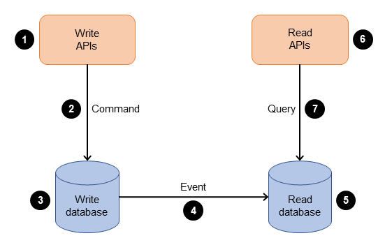
CQRS

Slide 23
Why CQRS?
Performance
Easy to implement
Support caching
Distributed transactions problems (2PC or Saga)

Slide 24
Simple model
Service A
API
Gateway
(logging, monitoring, auth, circuit breaker,…)
Pod 1
Pod 3
Pod 1
Pod 3
Pod 2
Pod …
Pod 2
Pod …
/serviceA/v1
/serviceA/v2
/serviceB/v2
Service B
Pod 1
Pod 3
Pod 1
Pod 3
/serviceB/v1
Pod 2
Pod …
Pod 2
Pod …

Slide 25
Simple model
Service A
Data
Service
(CQRS)
Caching
(Optional)
Data Storage A
Service B
Data Storage B

Slide 26
Implementation in ECMBPM
API Gateway (Independent with common API Gateway)
Business and functionality models: genform, batch jobs,… (saving a lot of resources)
Integration services???

